Slide 1

Drumea Alexandru-Daniel
Coordonator: Prof. Dr. Cristea Dan

Slide 2
The Problem?
How can one facilitate the summarization of CVs in order for HR departments to process large quantities of data?
How can one efficiently analyze data in Customer Support such that the response for a complaint to be forwarded to the appropriate department to handle?

Slide 3
The Solution?
NER – Named Entity Recognition
Named entity recognition is a subtask of information extraction that seeks to locate and classify mentions of known named entities in unstructured texts into pre-determined categories
The categories?
The most widely used categories are person names, organization names, geographical locations and miscellaneous such as date and time, geo-political relations.

Slide 4
State-of-the-art
The Stanford Named Entity Recognition Software
The SpaCy Entity Recognition
The Gazetteer Method

Slide 5
The Stanford Named Entity Recognition Software
Uses the Conditional Random Field Algorithm in order to predict the features of an unknown word.
All word features are stored in a window
The Stanford Named Entity Recognition Software is highly used in the academical purposes

Slide 6
SpaCy
Free, open source library that has made Natural Language Processing (NLP) much simpler in Python.
Provides users with a statistical system which is highly efficient for named entity recognition
Uses Convolutional Neural Networks

Slide 7
Gazetteer
It implies the creation of a different list for each of the type of entities.
Tag the unannotated body of text using a Part of Speech Tagger
Search the respective lists for each word / group of words identified by the Part of Speech Tagger

Slide 8
Application of NER for the Romanian Language
The aforementioned methods provides an accuracy score of over 90% for the languages they are trained on.
For the Romanian Language? Not so good.
The problem?
Scarce models for this language, complexity of the topic of the language.
The Solution?
Combining the three methods using a voting function, training on Romanian Language corpora.

Slide 9
QuoVadis & RONEC
QuoVadis
A corpus displaying semantic relations in free text.
The knowledge base is built in such a way as to facilitate the training of programs aiming to automatically recognize in text entities and semantic relations.
RONEC
A corpus of annotated data consisting of 5127 sentences with a total of 26376 entities

Slide 10
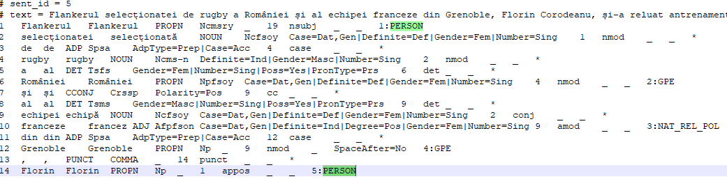
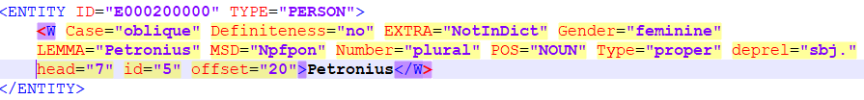
Formats
RONEC
QuoVadis

Slide 11
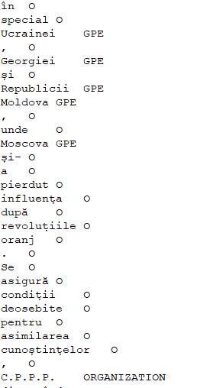
The Format of the Training Data
The format is the ConLL-U Plus format.
The values are stored in two columns separated by <tab>.
Every word and punctuation sign is a new line.
Facilitates the training of the model.

Slide 12
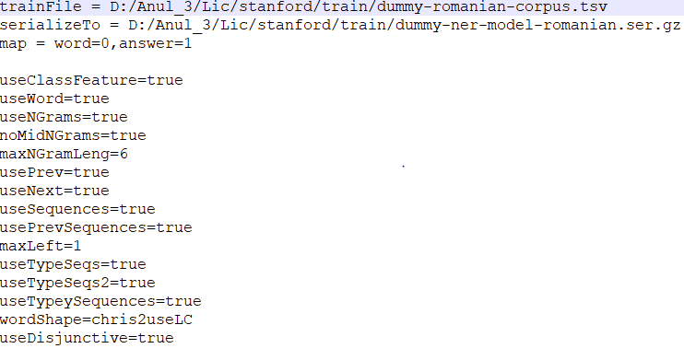
Training the corpus
Write the proprieties file.
Run the Stanford Trainer.

Slide 13
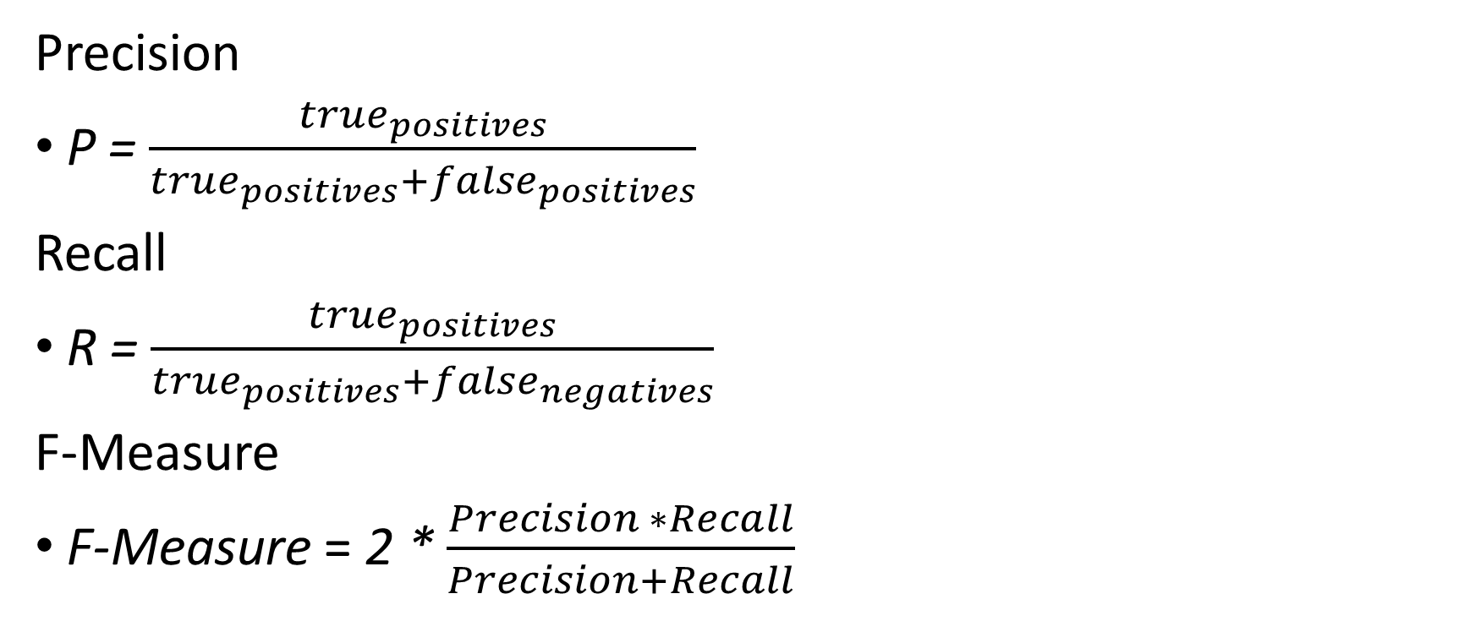
Metrics
Precision
P = $\frac{true_{positives}}{true_{positives}+false_{positives}}$
Recall
R = $\frac{true_{positives}}{true_{positives}+false_{negatives}}$
F-Measure
F-Measure = 2 * $\frac{Precision ∗Recall}{Precision+Recall}$

Slide 14
Statistics
The test values file is composed of 20 sentences.
2 characteristics for each sentence: raw text and manually annotated
Comprise each category (false positives, true positives, false negatives, true negatives)
Compute each metric.

Slide 15

Results
Precision
Recall
F-Measure

Slide 16
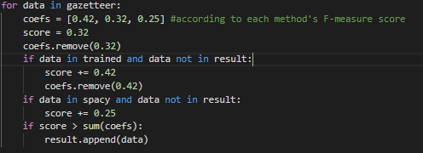

Voting
The influence on the final result will be the result of a weighing formula.
$w_{i}$ = $\frac{f_{i}}{\sum_{i=1}^{3}{f_{i}}}$
The weights of each method: 0.42, 0.32, 0.25

Slide 17
Web Application
Fairly simple.
The user input is extracted from the front-end.
Passed on to the voting function.
The voting function will do the named entity recognition.
A beautify function will return the HTML friendly code to the frontend.
DEMO

Slide 18
Conclusions
The F-Measure score reached is 88%.
The most influent classification is the Stanford NER.
The Gazetteer method is best with person names.
SpaCy is best with noun-phrases.
Improvements are required in the form of larger, more comprehensive corpora, larger, more ambiguous contexts.

